Slide 1


CS-446: Information Systems Security
Lecture # 19: Firewalls
Prof. Dr. Sufian Hameed
Department of Computer Science
FAST-NUCES

Slide 2
Outline
What are firewalls?
Types of Firewalls
Building a simple firewall using Netfilter
Iptables firewall in Linux
Stateful Firewall
Application Firewall
Evading Firewalls

Slide 3
Firewalls
A part of computer system or network designed to stop unauthorized traffic flowing from one network to another.
Separate trusted and untrusted components of a network.
Differentiate networks within a trusted network.
Main functionalities are filtering data, redirecting traffic and protecting against network attacks.

Slide 4
Requirements of a firewall
All the traffic between trust zones should pass through firewall.
Only authorized traffic, as defined by the security policy, should be allowed to pass through.
The firewall itself must be immune to penetration, which implies using a hardened system with secured Operating Systems.

Slide 5
Firewall Policy
User control: Controls access to the data based on the role of the user who is attempting to access it. Applied to users inside the firewall perimeter.
Service control: Controls access by the type of service offered by the host. Applied on the basis of network address, protocol of connection and port numbers.
Direction control: Determines the direction in which requests may be initiated and are allowed to flow through the firewall. It tells whether the traffic is “inbound” (From the network to firewall) or vice-versa “outbound”

Slide 6
Firewall actions
Accepted: Allowed to enter the connected network/host through the firewall.
Denied: Not permitted to enter the other side of firewall.
Rejected: Similar to “Denied”, but tells the source about this decision through ICMP packet.
Ingress filtering: Inspects the incoming traffic to safeguard an internal network and prevent attacks from outside.
Egress filtering: Inspects the outgoing network traffic and prevent the users in the internal network to reach out to the outside network. For example like blocking social networking sites in school

Slide 7
Types of filters
Depending on the mode of operation, there are three types of firewalls :
Packet Filter Firewall
Stateful Firewall
Application/Proxy Firewall

Slide 8
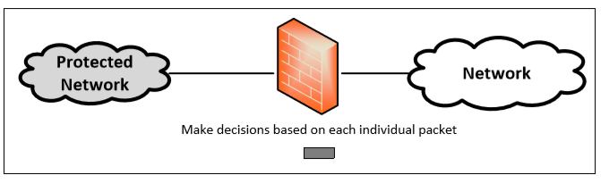
Packet Filter Firewall
Controls traffic based on the information in packet headers, without looking into the payload that contains application data.
Doesn’t pay attention to if the packet is a part of existing stream or traffic.
Doesn’t maintain the states about packets. Also called Stateless Firewall.

Slide 9
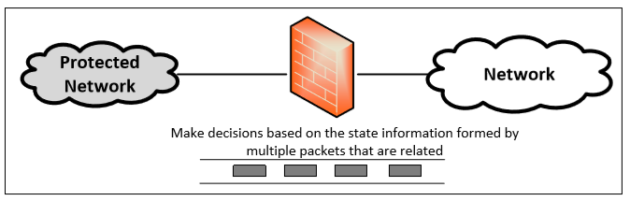
Stateful Firewall
Tracks the state of traffic by monitoring all the connection interactions until is closed.
Connection state table is maintained to understand the context of packets.
Example : Connections are only allowed through the ports that hold open connections.

Slide 10
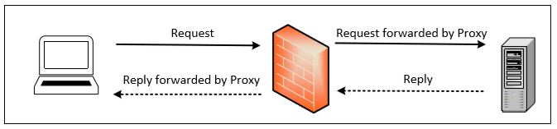
Application/Proxy Firewall
Controls input, output and access from/to an application or service.
Acts an intermediary by impersonating the intended recipient.
The client’s connection terminates at the proxy and a separate connection is initiated from the proxy to the destination host.
Data on the connection is analyzed up to the application layer to determine if the packet should be allowed or rejected.
Notes:
Limitation : Need to implement new proxies to handle new protocols. Slower compared to other firewalls
Advantage : Ability to authenticate users directly rather than depending on network addresses of the system. Reduces the risk of IP spoofing attacks that are easy to launch against a network.

Slide 11
Building a Firewall using Netfilter
Packet filter firewall implementation in Linux
Packet filtering can be done inside the kernel.
Need changes in the kernel
Linux provides two mechanisms to achieve this :
Netfilter: Provides hooks at critical points on the packet traversal path inside Linux Kernel.
Loadable Kernel Modules: Allow privileged users to dynamically add/remove modules to the kernel, so there is no need to recompile the entire kernel.

Slide 12
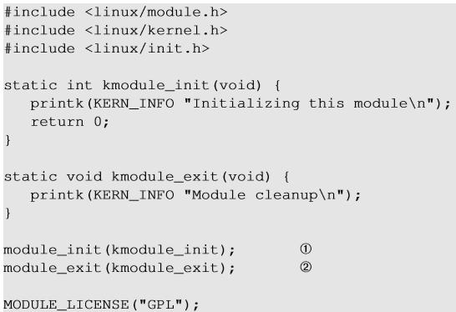
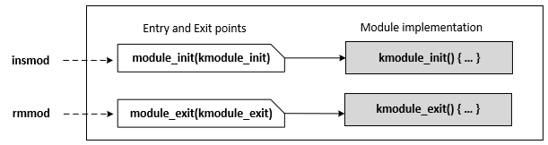
Loadable Kernel Modules
Specify an initialization function that will be invoked when the kernel module is inserted.
Specify a cleanup function that will be invoked when the kernel module is removed.

Slide 13
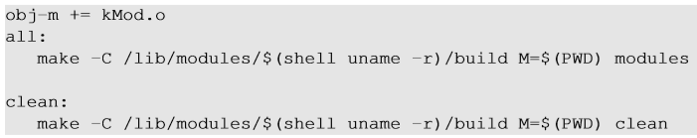
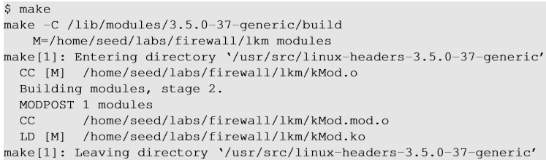

Compiling Kernel Modules
Makefile
M: Signifies that an external module is being built and tells the build environment where to place the built module file.
C: Specify the directory of the library files for the kernel source.
Notes:
Linux distribution comes with its own way to download header and configuration files storedin /usr/src directory.
When we execute make command, the make process will change to the specified directory and change back when finished as shown.

Slide 14
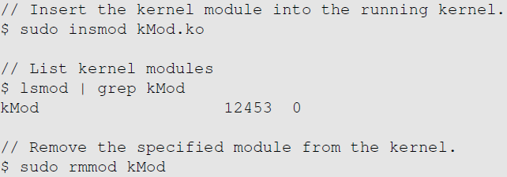
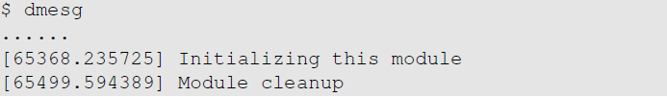
Installing Kernel Modules
In the sample code, we use printk() to print out messages to the kernel buffer. We can view the buffer using dmesg.

Slide 15
Netfilter
Netfilter hooks are rich packet processing and filtering framework.
Each protocol stack defines a series of hooks along the packet’s traversal path in the stack.
Developers can use LKMs to register callback functions to these hooks.
When a packet arrives at each of these hooks, the protocol stack calls the netfilter framework with the packet and hook number.
Netfilter checks if any kernel module has registered a callback function at this hook.
Each registered module will be called, and they are free to analyze or manipulate the packet and return the verdict on the packet.

Slide 16
Netfilter: Verdict on Packets (Return Values)
NF_ACCEPT: Let the packet flow through the stack.
NF_DROP: Discard the packet.
NF_QUEUE: Pass the packet to the user space via nf_queue facility.
NF_STOLEN: Inform the netfilter to forget about this packet, The packet is further processed by the module.
NF_REPEAT: Request the netfilter to call this module again.

Slide 17
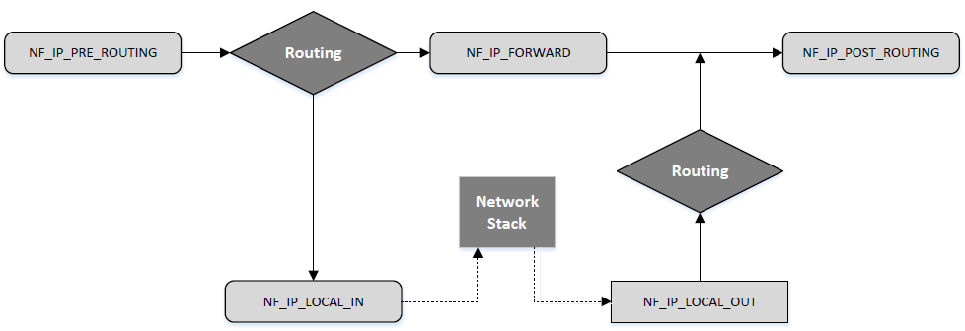
Netfiler Hooks for IPv4
Notes:
NF_IP_LOCAL_OUT: Before the packets are in their way out of the host.
NF_IP_POST_ROUTING: After the packets are out of the host and entering a different network.
NF_IP_PRE_ROUTING: Before any routing decision is made
NF_IP_LOCAL_IN: Before being sent to the network stack
NF_IP_FORWARD: Forward packets to other hosts.

Slide 18
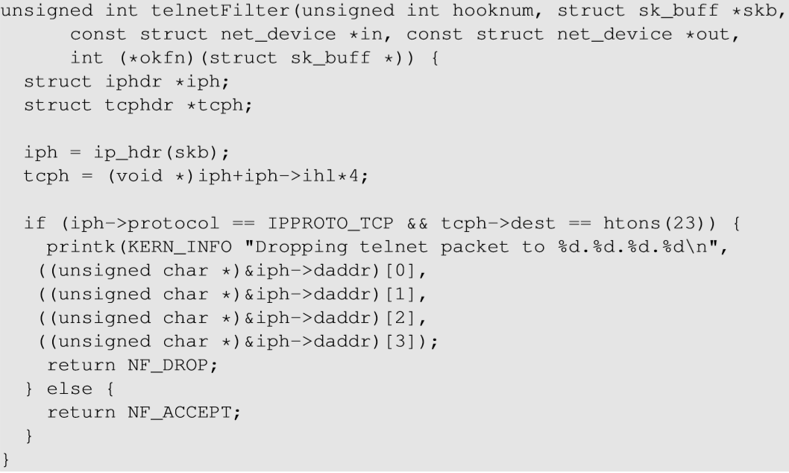
Implementing a Simple Packet Filter Firewall
The entire packet is provided here.
The filtering logic is hardcoded here. Drop the packet if the destination TCP port is 23 (telnet)
Decisions

Slide 19
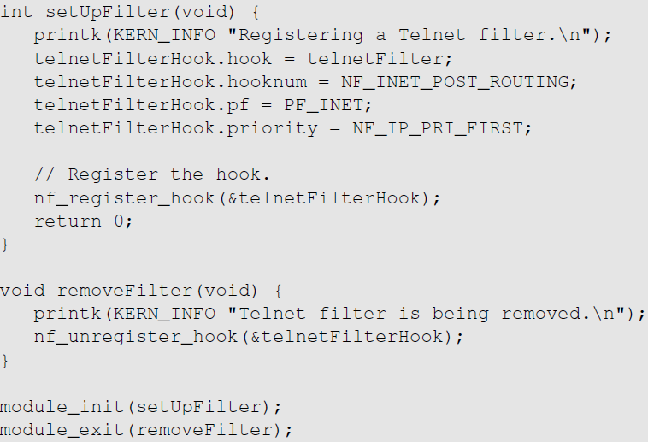
Implementing a Simple Packet Filter Firewall
Hook this callback function
Use this Netfilter hook
Register the hook

Slide 20
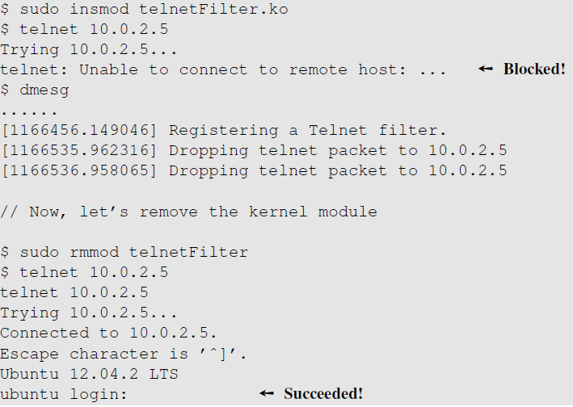
Testing Our Firewall
Notes:
After using insmod to add the module into the kernel, we can try to telnet to any machine.
We can see that telnet attempt fails with dropping packet messages.
If we remove the kernel module, telnet is successful.

Slide 21
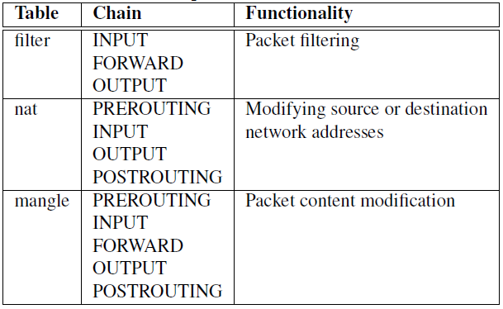
Iptables Firewall in Linux
Iptables is a built-in firewall based on netfilter.
Kernel part: Xtables
User-space program: iptables
Usually, iptables refer to both kernel and user space programs.
Rules are arranged in hierarchical structure as shown in the table.

Slide 22
Iptables Firewall - Structure
Each table contains several chains, each of which corresponds to a netfilter hook.
Each chain indicates where its rules are enforced.
Example : Rules on FORWARD chain are enforced at NF_IP_FORWARD hook and rules on INPUT chain are enforced at NF_IP_LOCAL_IN hook.
Each chain contains a set of firewall rules that will be enforced.
User can add rules to the chains.
Example : To block all incoming telnet traffic, add a rule to the INPUT chain of the filter table

Slide 23
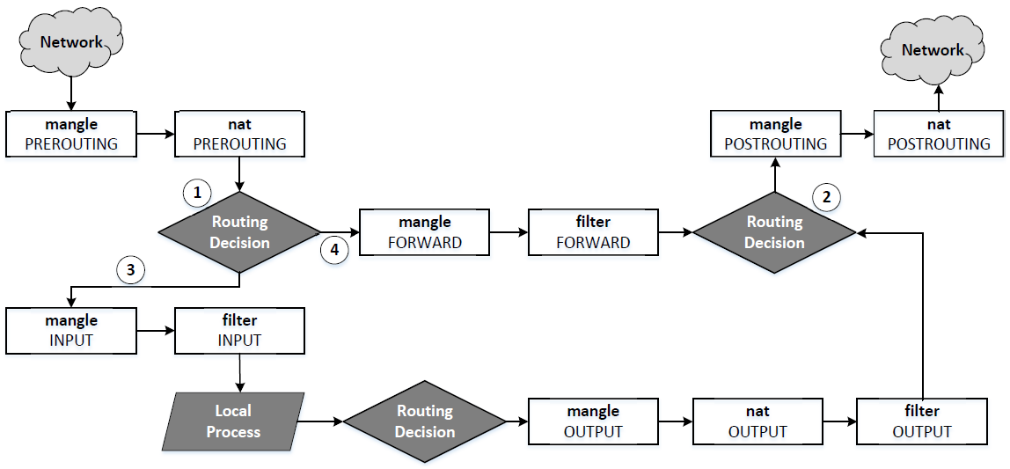
Traversing Chains and Rule Matching

Slide 24
Traversing Chains and Rule Matching
1 - Decides if the final destination of the packet is the local machine
3 - Packet traverses through INPUT chains
4 - Packet traverses through FORWARD chains
2 - Decides from which of the network interface to send out outgoing packets
As a packet traverses through each chain, rules on the chain are examined to see whether there is a match or not. If there is a match, the corresponding target action is executed: ACCEPT, DROP or jumping to user-defined chain.

Slide 25
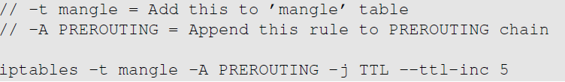
Traversing Chains and Rule Matching
Example: Increase the TTL field of all packets by 5.
Solution: Add a rule to the mangle table and choose a chain provided by netfilter hooks. We choose PREROUTING chain so the changes can be applied to all packets, regardless they are for the current host or for others.

Slide 26
Iptables Extension
Iptables functions can be extended using modules also called as extensions.
Two Examples:
Conntrack: To specify rules based on connections to build stateful firewalls.
Owner: To specify rules based on user ids. Ex: To prevent user Alice from sending out telnet packets. Owner module can match packets based on the user/group id of the process that created them. This works only for OUTPUT chain (outgoing packets) as it is impossible to find the user ids for INPUT chain(incoming packets).

Slide 27
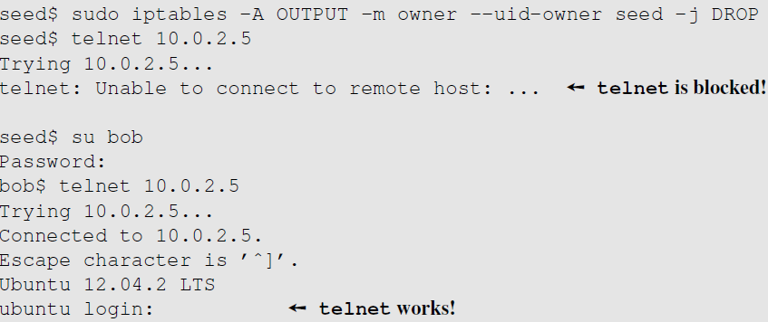
Iptables Extension: Block a Specific User
This rule drops the packets generated by any program owned by user seed. Other users are not affected.

Slide 28
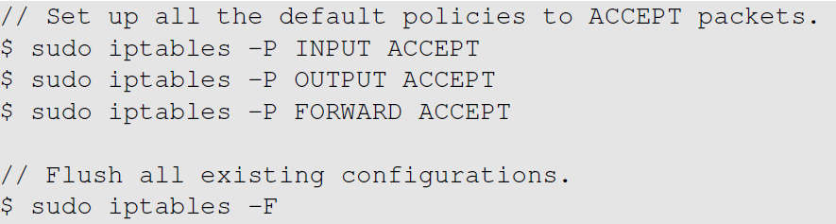
Building a Simple Firewall
Flush all existing firewall configurations
Default policy is set to ACCEPT before all the rules.

Slide 29
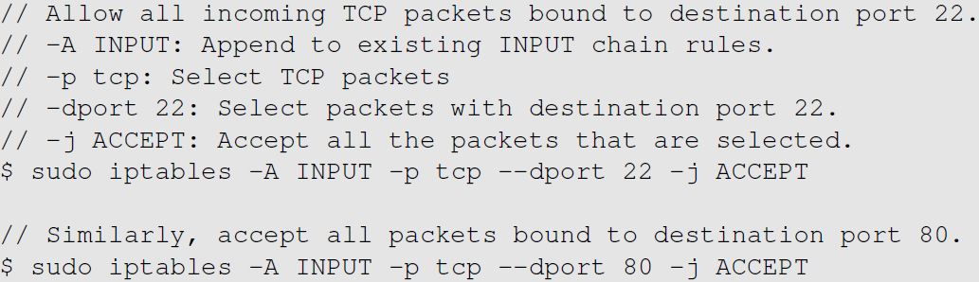
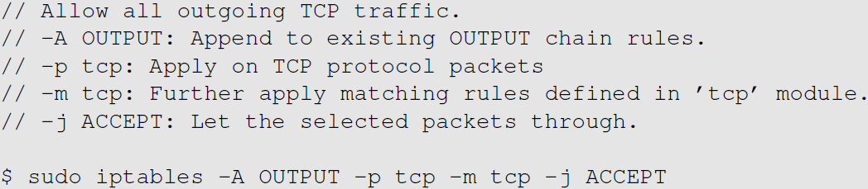
Building a Simple Firewall
Rule on INPUT chain to allow TCP traffic to ports 22 and 80
Rule on OUTPUT chain to allow all outgoing TCP traffic

Slide 30
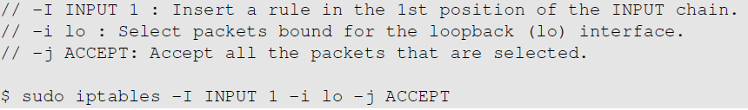

Building a Simple Firewall
Allow the use of the loopback interface.
Allow DNS queries and replies to pass through.

Slide 31
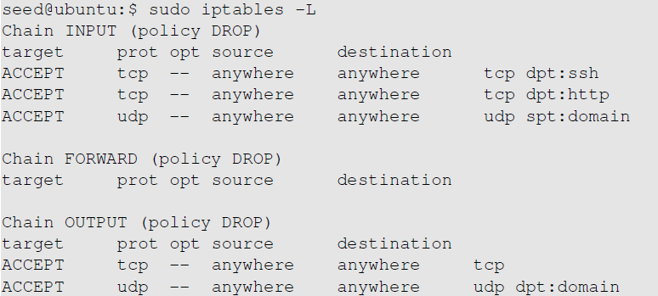
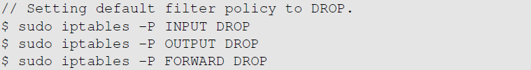
Building a Simple Firewall
These are all the rules we have added
Change the default policy to DROP so that only our configurations on firewall work.

Slide 32
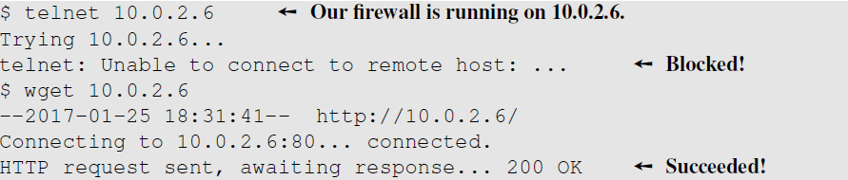
Building a Simple Firewall: Testing
To test our firewall, make connection attempts from a different machine.
Firewall drops all packets except the ones on ports 80(http) and 22(ssh).
Telnet connection made on port 23 failed to connect, but wget connection on port 80 succeeded.
Notes:
After the experiment, remove all the rules by allowing traffic on all the chains and flushing out the existing configurations

Slide 33
Stateful Firewall using Connection Tracking
A stateful firewall monitors incoming and outgoing packets over a period of time.
Records attributes like IP address, port numbers, sequence numbers. Collectively known as connection states.
A connection state, in context of a firewall signifies whether a given packet is a part of an existing flow or not.
Hence, it is applied to both connection-oriented (TCP) and connectionless protocols (UDP and ICMP).

Slide 34
Connection Tracking Framework in Linux
nf_conntrack is a connection tracking framework in Linux kernel built on the top of netfilter.
Each incoming packet is marked with a connection state as described:
NEW: The connection is starting and packet is a part of a valid sequence. It only exists for a connection if the firewall has only seen traffic in one direction.
ESTABLISHED: The connection has been established and is a two-way communication.
RELATED: Special state that helps to establish relationships among different connections. E.g., FTP Control traffic and FTP Data traffic are related.
INVALID : This state is used for packets that do not follow the expected behavior of a connection.
iptables can use nf_conntrack to build stateful firewall rules.

Slide 35
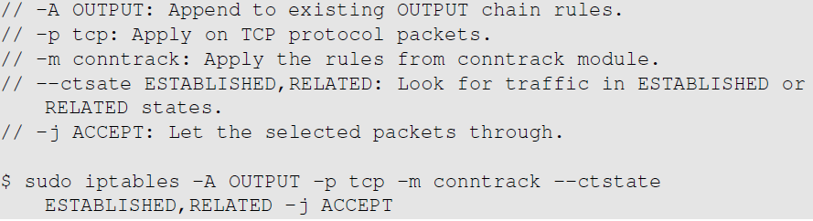
Example: Set up a Stateful Firewall
To set up a firewall rule to only allow outgoing TCP packets if they belong to an established TCP connection.
We only allow ssh and http connection and block all the outgoing TCP traffic if they are not part of an ongoing ssh or http connection.
We will replace the earlier rule with this one based on the connection state.
Notes:
The earlier firewall allowed all the outgoing TCP traffic. An attacker who compromises an internal host can exfiltrate data over TCP. The connection cannot be made as incoming traffic is blocked. But this is sufficient for exfiltrating data. To avoid such attacks, we need to setup stateful firewalls

Slide 36
Application/Proxy Firewall and Web Proxy
Inspects network traffic up to the application layer.
Typical implementation of an application firewall is a proxy (application proxy)
Web proxy: To control what browsers can access.
To set up a web proxy in a network, we need to ensure that all the web traffic goes through the proxy server by:
Configuring each host computer to redirect all the web traffic to the proxy. (Browser’s network settings or using iptables)
Place web proxies on a network bridge that connects internal and external networks.

Slide 37
Application/Proxy Firewall and Web Proxy
Proxy can also be used to evade egress filtering.
If a firewall conducts packet filtering based on destination address, we can evade this firewall by browsing the Internet using web proxy.
The destination address will be modified to the proxy server which defeats the packet filtering rules of the firewall.
Anonymizing Proxy: One can also use proxies to hide the origin of a network request from servers. As the servers can only see the traffic after it passes through proxies, source IP will be the proxy’s and actual origin is hidden.

Slide 38
Evading Firewalls
SSH Tunneling
Dynamic Port Forwarding
Virtual Private Network

Slide 39
SSH Tunneling to Evade Firewalls
Scenario :
We are working in a company and need to telnet to a machine called “work”. Sometimes as we work from home, we need to telnet from machine “home” to “work”. However, the company’s firewall blocks all incoming traffic which makes telnet from “home” impossible.The company’s firewall does allow ssh traffic to reach its internal machine “apollo”, where we have an account. How can we use this machine to evade the firewall?

Slide 40
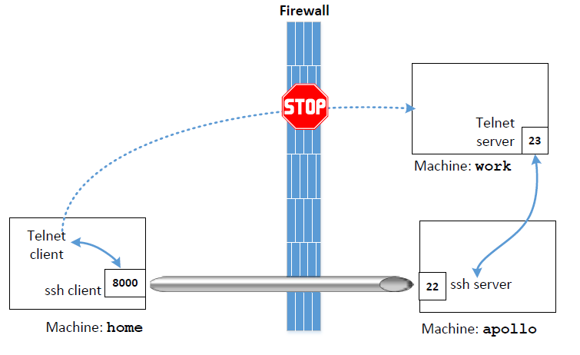
SSH Tunneling to Evade Firewalls
Establish a ssh tunnel between “home” and “apollo”.
On the “home” end, the tunnel receives TCP packets from the telnet client.
It forwards the TCP data to “apollo” end, from where the data is out in another TCP packet which is sent to machine “work”.
The firewall can only see the traffic between “home” and “apollo” and not from “apollo” to “work”. Also ssh traffic is encrypted.

Slide 41
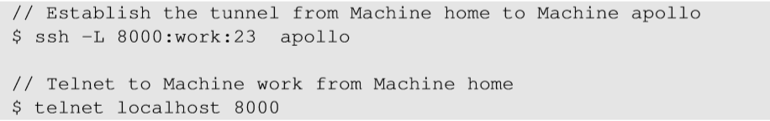
SSH Tunneling to Evade Firewalls
Establish an ssh tunnel from “home” to “apollo”. This tunnel will forward TCP data received on 8000 on “home” to port 23 on work.
After establishing the tunnel, telnet to the 8000, and the telnet traffic will be forwarded host work via the ssh tunnel.

Slide 42
SSH Tunneling to Evade Firewalls
Scenario :We are working in a company and working on a machine called “work”. We would like to visit Facebook, but the company has blocked it to prevent employees from getting distracted. We use an outside machine “home” to bypass such a firewall. How can we bypass it?
We establish an ssh tunnel from “work” to “home”.
After establishing the tunnel, we can type “localhost:8000” in our browser.
The tunnel will forward our HTTP requests to Facebook via home.
The firewall can only see the ssh traffic between “work” and “home” and not the actual web traffic between “work” and “Facebook”.

Slide 43
Dynamic Port Forwarding
This command establishes an ssh tunnel between localhost (port 9000) and the machine “home”. Here we do not specify the destination for the port forwarding.
So, we configure the browser in such a way that all the requests should go through localhost:9000, treating it as a proxy.
Dynamic port forwarding that we set up using ssh is a SOCKS proxy.
Once the browser is configured, we can type URL of any blocked site which will connect to ssh proxy at port 9000 on the localhost.
ssh will send the TCP data over the tunnel to the machine “home” which will communicate with the blocked site.

Slide 44
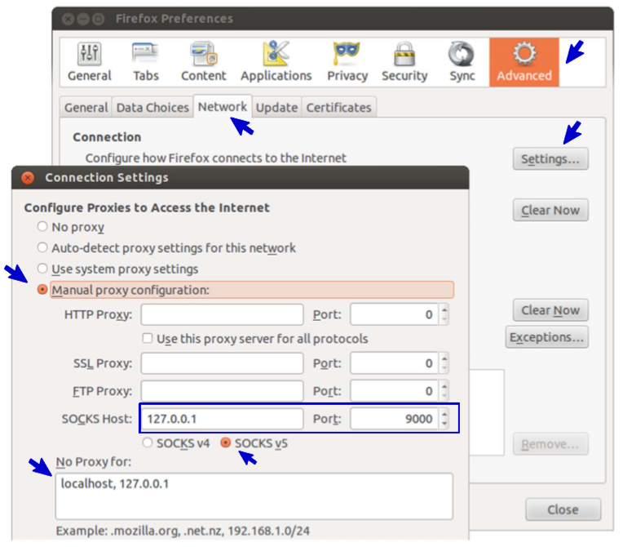
Dynamic Port Forwarding
The client software must have a native SOCKS support to use SOCKS proxies.

Slide 45
Using VPN to Evade Firewall
Using VPN, one can create a tunnel between a computer inside the network and another one outside. IP packets can be sent using this tunnel. Since the tunnel traffic is encrypted, firewalls are not able to see what is inside this tunnel and cannot conduct filtering. This topic is covered in detail late in VPN topic.

Slide 46
Summary
The concept of firewall
Implement a simple firewall using netfilter
Using iptables to configure a firewall
Stateful firewalls and web proxy
Bypassing firewalls

Slide 47
Acknowledgements
Material in this lecture are taken from the slides prepared by:
Prof. Wenliang Du

